Slide 1



Machine Learning Based ESports Winner Prediction
ShanghaiTech CS181 Project : LOL Esports Prediction
连奕航/邬一闻/熊昕洋/吕钧霆/余诗博

Slide 2


01
Introduction
When watching esports matches,
did you notice this?

Slide 3
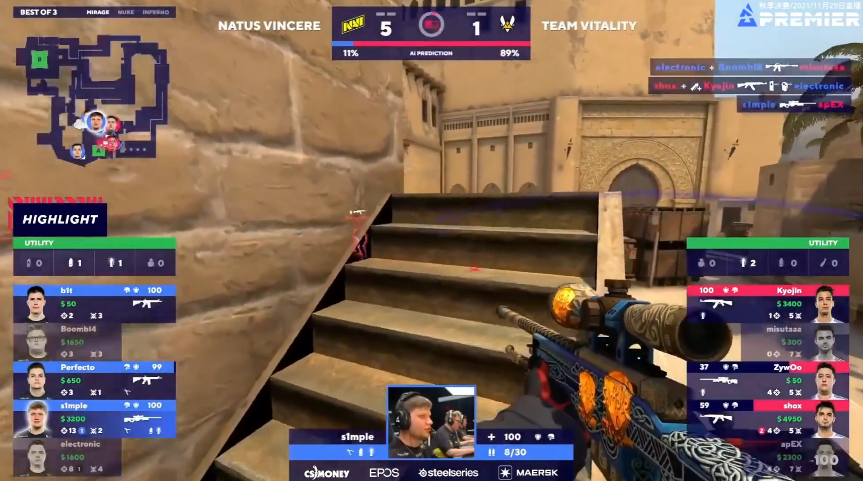
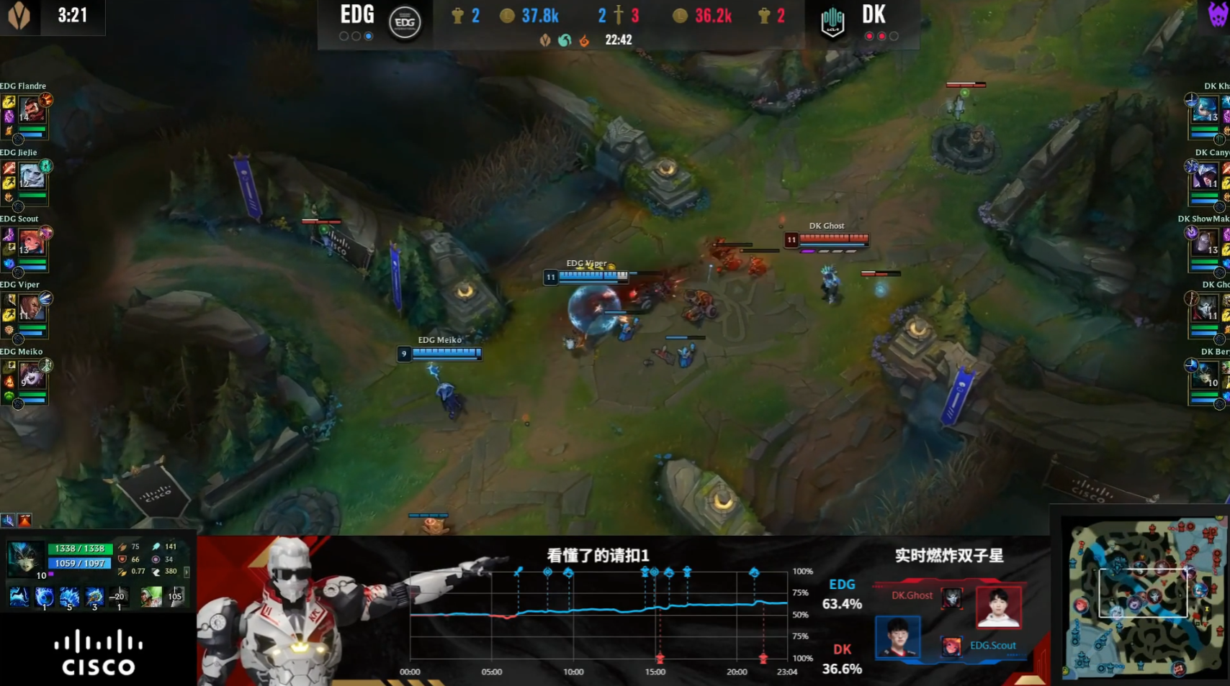
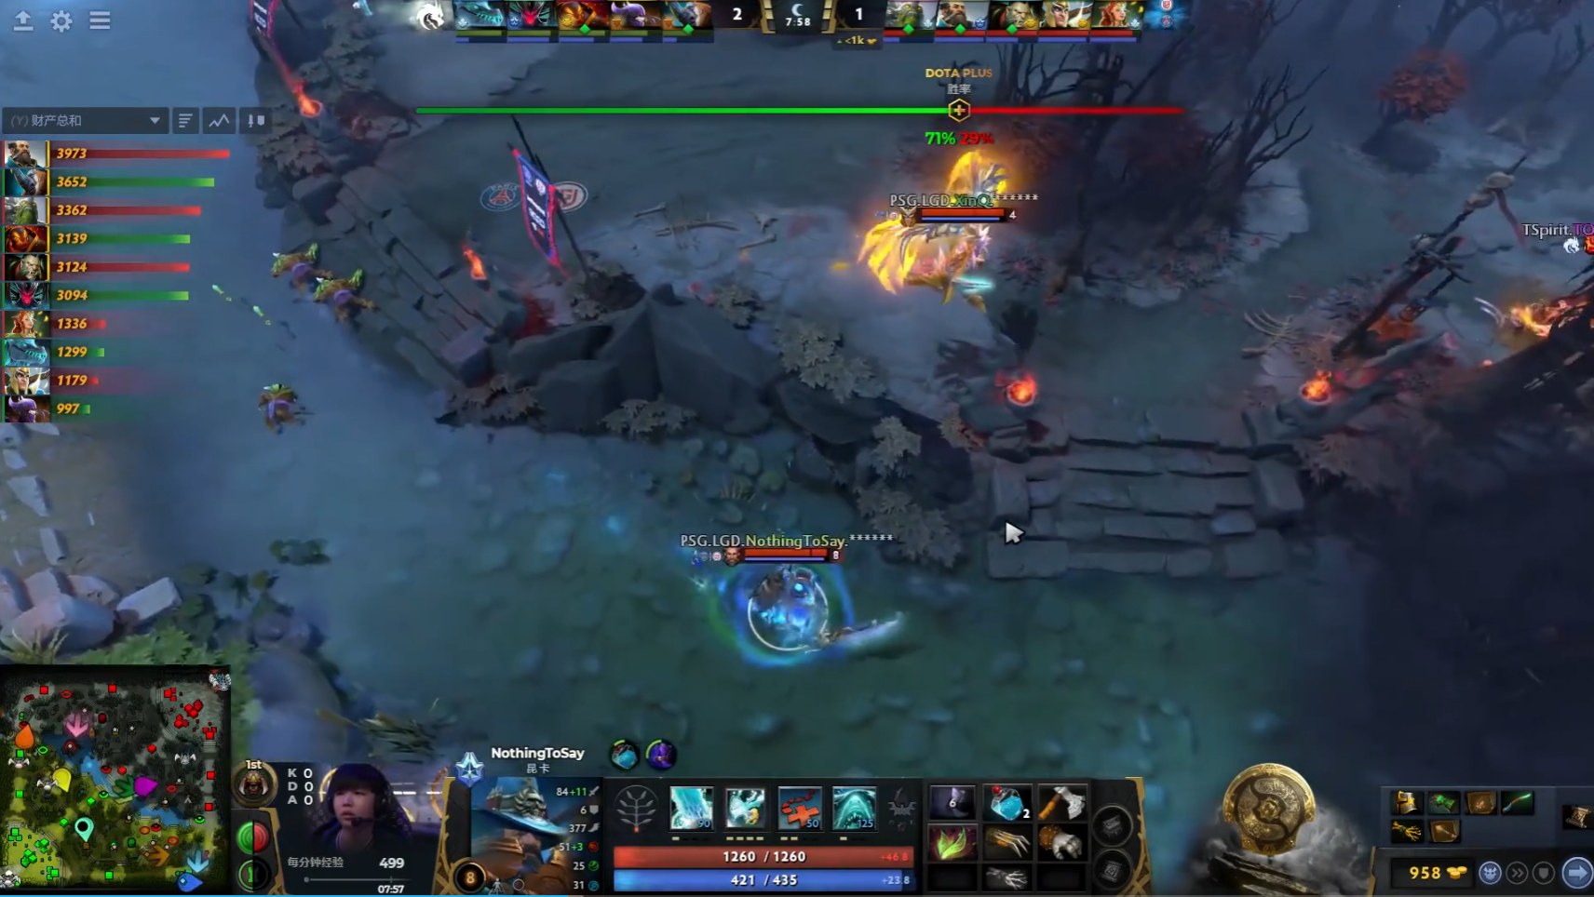
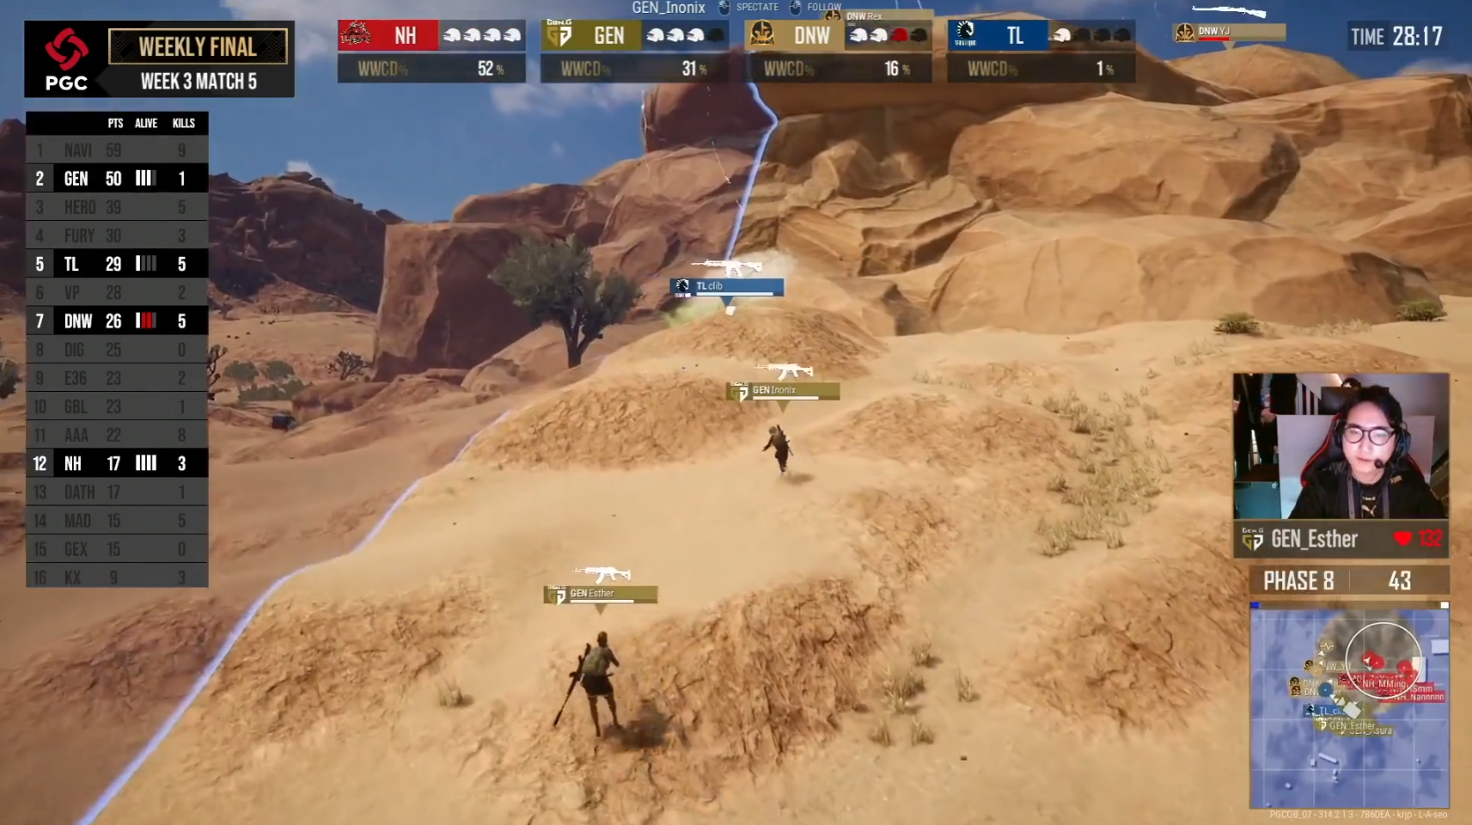
CSGO
LOL
BLAST Premier: Fall Finals 2021
S11 World Championship
DOTA2
PUBG
The International 10
Global Championship 2021

Slide 4
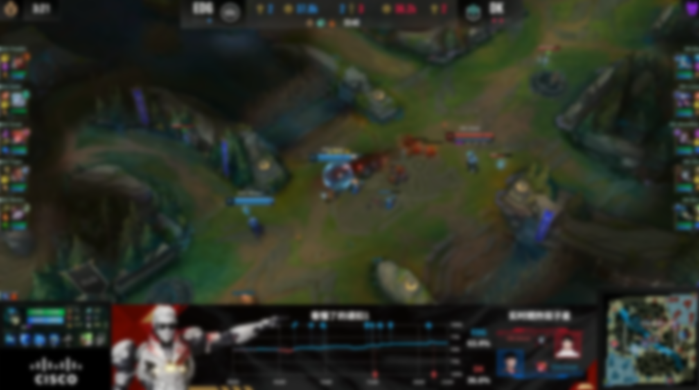
Example: KI Colonel (KFC-AI) Realtime Win Rate
Who to win the game?
LOL Esports Winner Prediction
?

Slide 5


02
Our Methods
How to determine who can win the game?

Slide 6
WHO WILL WIN THE GAME?
?

Slide 7




WHO WILL WIN THE GAME?
CHAMPION
LINEUP?
IN-GAME
PERFORMANCE?

Slide 8
Supervised Machine Learning Approach
0
1
1
0
f( , ) = ( ) or ( )
CHAMPION LINEUP
IN-GAME
PERFORMANCE
ENCODING
CLASSIFICATION
Extract feature vector
from current game state
dimensions of vector
= # of players

Slide 9
Champion Lineup: Naïve Bayes

Slide 10

Champion Lineup: Naïve Bayes
Laplace Smoothing
P(Y)
Y = { Red, Blue }
$$P\left(Y,F1,F2,⋯,Fn\right)$$
$=P(Y)\prod_{i}{P(Fi|Y)}$
$$P(Y|F1,F2,⋯,Fn)$$
TOP JUNGLE MIDDLE ADC SUPPORT
TOP JUNGLE MIDDLE ADC SUPPORT
P(F_{i}|Y) i=1, 2, …, 10

Slide 11
Champion Lineup: Naïve Bayes
Result & Thoughts
Result:
54.0% on 2021 pro matches dataset
52.7% on 2015-2018 pro matches dataset
even monkey can get 50% accuracy. . .
Why poor performance?
Naïve Bayes assumes conditional independence on champions
however, champion cooperation&counter matters!
Pro players might be influenced little by champion lineup
they tend to pick OP champion lineup as possible
Game patch differs

Slide 12
Champion Lineup: Logistic Regression
Result & Thoughts
f( ) = ( ) or ( )
0
1
1
0
TOP JUN MID ADC SUP TOP JUN MID ADC SUP
Using Gradient Descent to optimize log loss with sigmoid probability
Result:
54.1% on 2021 pro matches dataset
53.2% on 2015-2018 pro matches dataset
This can prove champion lineup less matters to pros than expected

Slide 13
In-Game Performance
0
1
f( , , , ) = ( ) or ( )
1
0
Gold Tower Kill Dragon

Slide 14
In-Game Performance: Logistic Regression
Result & Thoughts
0
1
f( , , , ) = ( ) or ( )
1
0
Gold Tower Kill Dragon
Similarly, using Gradient Descent to optimize loss
Features captured:
Difference between blue and red in . . .
. . . gold earned/enemies killed/towers destroyed/monsters killed
At certain timestep (early stage), like t=15 minutes after beginning
Result:
76.0% on 2021 pro matches dataset
72.3% on 2015-2018 pro matches dataset

Slide 15
In-Game Performance: RNN
Realtime prediction based on Recurrent Neural Network
X_{t}=( , , , )_{t} t=1,2,…,T
Gold Tower Kill Dragon
We want to implement real time prediction!
Features at each previous time step are captured X1, X2, . . . , Xt
Our choice - RNN !
can encode arbitrary-length input (T=5, 10, 15, 20, 25, 30 in our project)
can do classification through an additional output layer
With LSTM cells, can preserve more information in early time steps
LSTM: Long Short Term Memory networks

Slide 16


In-Game Performance: RNN & LSTM
Using Toolkit: PyTorch
X_{t}=( , , , )_{t} t=1,2,…,T
Gold Tower Kill Dragon
nn.RNN nn.LSTM
batch size = 32, learning_rate = 0.001, loss_func = CrossEntropy, activation = ReLU, RNN hidden size = 256, LSTM num layers = 1, train:valid:test split ratio = 6:2:2, early stopping on valid accuracy

Slide 17
In-Game Performance: RNN
Realtime prediction based on Recurrent Neural Network
Result on 2015-2018 pro matches dataset :
58.0%
05 min
58.9%
RNN LSTM
66.5%
10 min
66.7%
RNN LSTM
73.1%
15 min
73.9%
RNN LSTM
77.3%
20 min
77.4%
RNN LSTM
82.7%
25 min
82.9%
RNN LSTM
84.4%
30 min
85.0%
RNN LSTM

Slide 18
In-Game Performance: RNN & LSTM
Using Toolkit: PyTorch
nn.RNN nn.LSTM
84.4%
30 min
85.0%
RNN LSTM
Improvement of LSTM seems not obvious from accuracy metric
But we can demonstrate their difference by following example

Slide 19
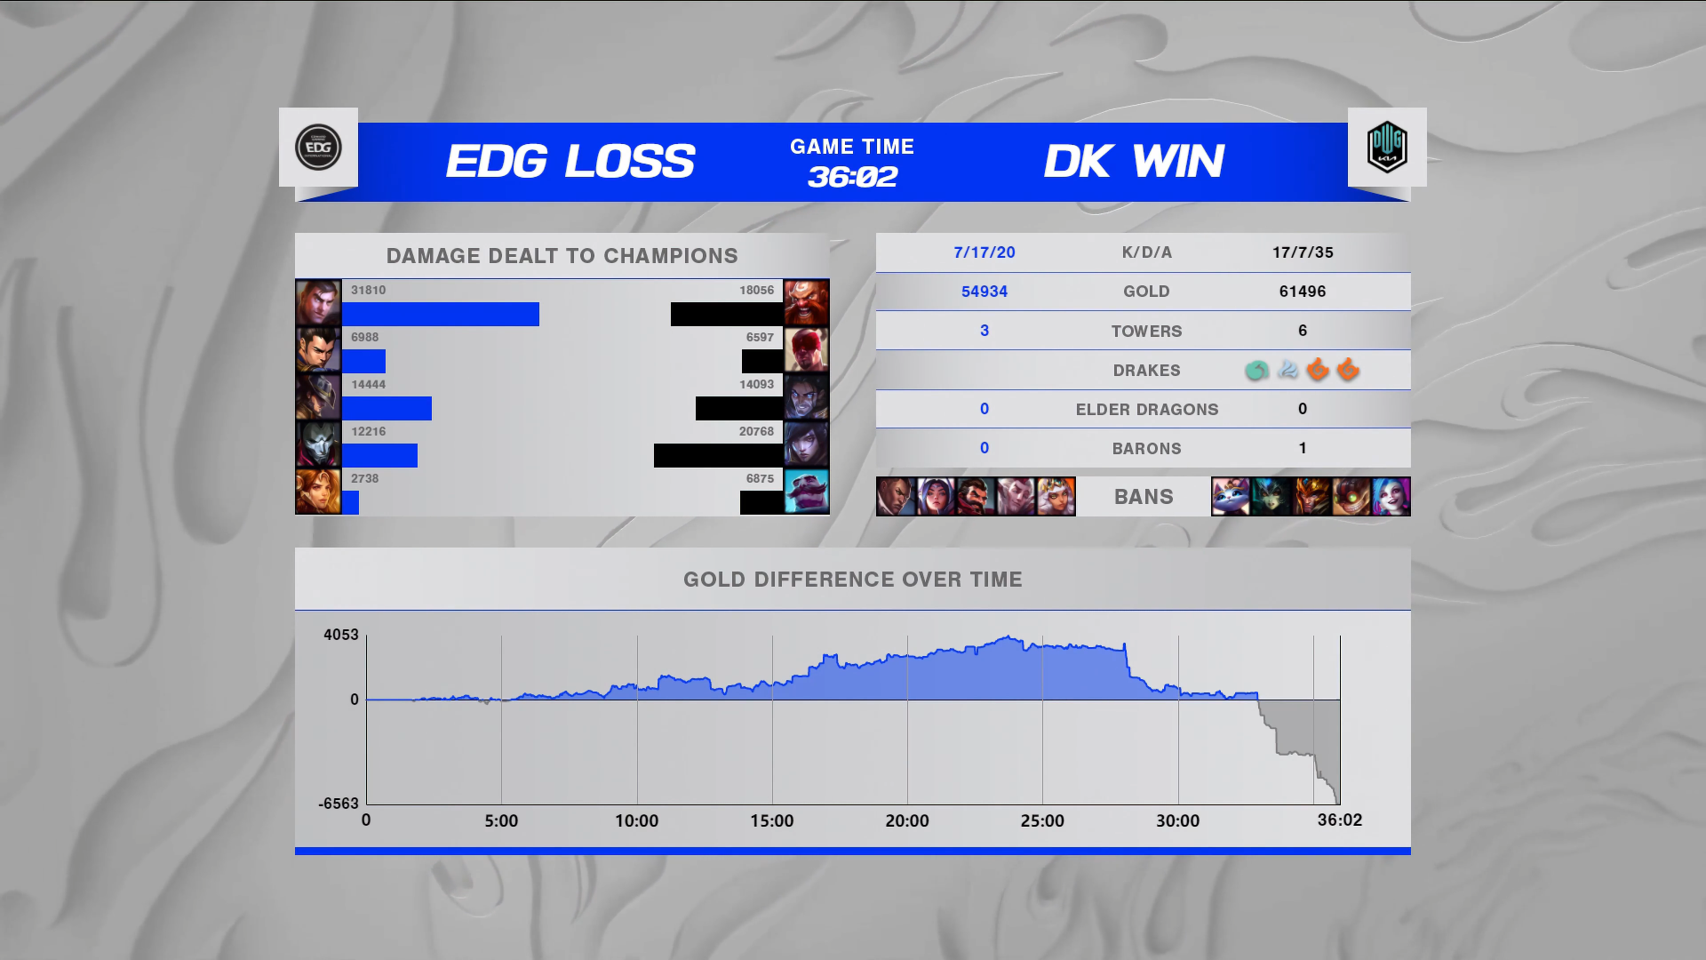
Let’s Predict S11 Final EDG vs DK Game 3 !
03

Slide 20

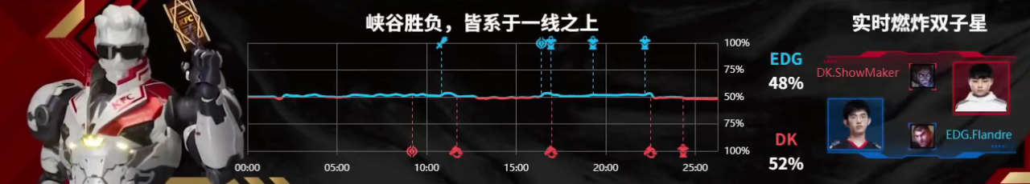
Predict S11 EDG vs DK Game 3
Source: KI Colonel (KFC-AI)

Slide 21
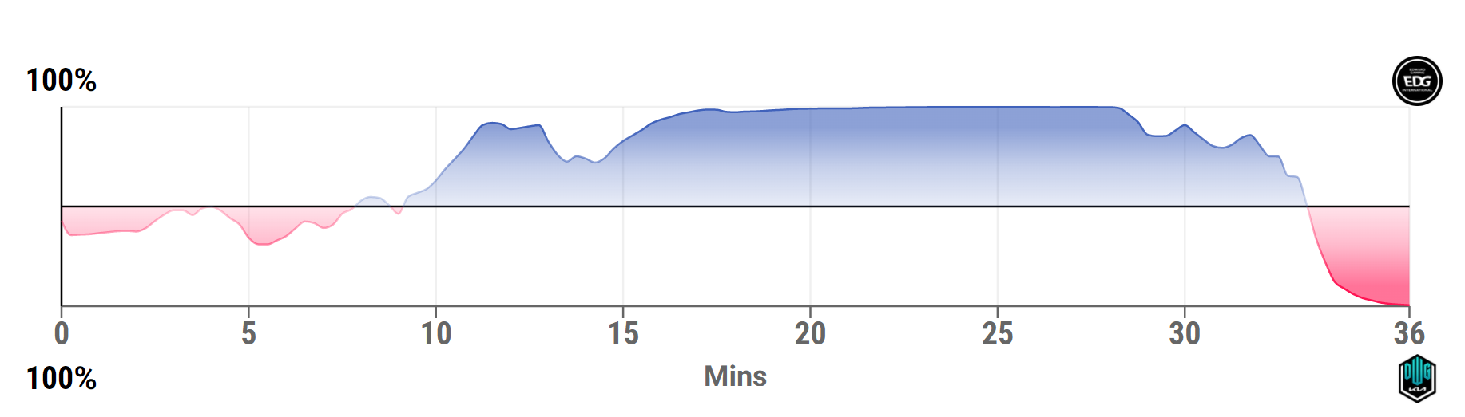
Predict S11 EDG vs DK Game 3
Source: FACTOR.GG

Slide 22
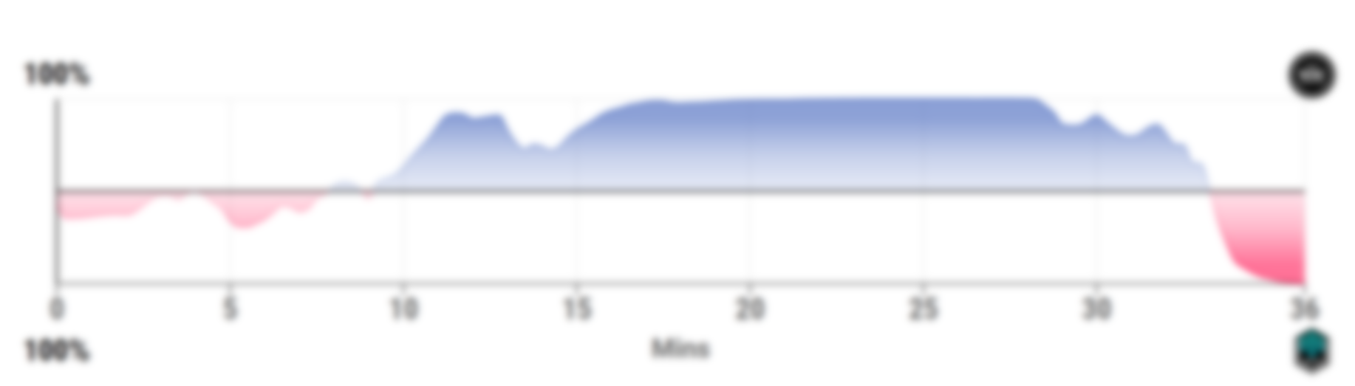
Predict S11 EDG vs DK Game 3
Our LSTM RNN Model Prediction!
EDG 62.0%
EDG 67.0%
EDG 53.4%
EDG 51.1%
DK 50.7%
DK 67.9%

Slide 23
Predict S11 EDG vs DK Game 3
Our RNN Model Prediction!
EDG 74.6%
EDG 66.1%
EDG 70.8%
EDG 54.1%
EDG 55.6%
DK 68.8%

Slide 24
Predict S11 EDG vs DK Game 3
Source: KI Colonel (KFC-AI)

Slide 25
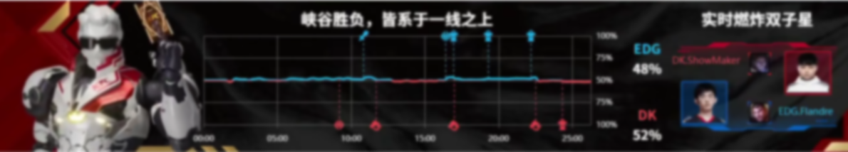

Predict S11 EDG vs DK Game 3
Our LSTM RNN Model Prediction!
EDG 62.0%
EDG 67.5%
EDG 53.4%
EDG 51.1%
DK 50.7%
DK 67.9%

Slide 26

THANKS!
Please keep this slide for attribution

